Slide 1

NVR COLLEGE OF ENGINEERING &TECHNOLOGY
SEMINAR REPORTED ON
TOPIC
LAMP TECHNOLOGY
SUBMITTED BY
S.POOJITHA
197T1A0545

Slide 2
CONTENTS
Introduction
Technologies Used in lamp
Where we use lamp
Architecture
Architecture consists of
Working
Security
Advantages of lamp
conclusion

Slide 3
WHAT IS LAMP..?
LAMP is a shorthand term for a web application platform consisting of linux, apache, my sql,and one of perl or PHP.
Lamp stands for :
L : linux
A: apache
M: my SQL
P : PHP
Lamp is an open source.
Together ,these open source tools provided a world-class platform for deploying web applications.

Slide 4
TECHNOLOGIES USED IN LAMP
LINUX
Linux is presently the most commonly used the implimentation of unix.
APACHE
Apache is the most popular web server on the internet.Apache like LINUX, MYSQL and PHP is an open source project.
MYSQL
MYSQL is a fast flexible relational database.MYSQL is the most widely used relational database.
PHP
PHP is the most popular scripting language for developing dynamic web based applications.

Slide 5
WHERE WE USE LAMP
LAMP used to
build secure scalable dynamic websites
LAMP has been touted as “the killer app” of the open source world
With many LAMP sites running ebusiness logic and ecommerce site and requiring 24*7 uptime,ensuring the highest levels of data and application availability is critical.

Slide 6
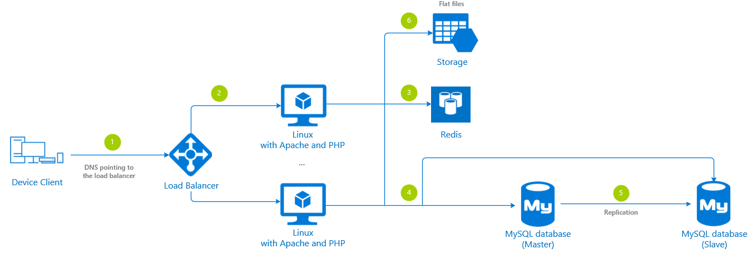
ARCHITECTURE

Slide 7
ARCHITECTURE CONSISTS OF
Web browser: which is used to run web application placing http req
Apache APL :which listen to the port 6o for http request
mod_PHP :passes the php scripts,my sql queries,receives result and returns to final html
My SQL server: stores data
Server running apache web server with mod_php,my sql server.

Slide 8
WORKING
One of the great “secrets” of almost all websites (aside from those that publish static.html pages) is that behind the scenes,the web server is actually just one part of a two or three tiered application server system.
in the open source world,this explains the tremendous popularity of the Linux-Apache-MYSQL-PHP(lamp)environment.
Lamp provides developers with a traditional two tiered application development platform.

Slide 9
SECURITY
The standard method is use the security and authentication features of the apache web server.the tool mod_auth allows for password based authentication.
You can also use allow/deny directives to limit access based on location.

Slide 10
ADVANTAGES & DISADVANTAGES
ADVANTAGES:
Scalability: Any app or website you build with LAMP stack development can grow in size or shrink depending on your requirement. ...
Highly secure: ...
Customization: ...
Independent platform: ...
Fast development
DISADVANTAGES:
The major disadvantage of LAMP is its heavy reliance on indirect detection methods like terbidity and non-specific dyes, which often leads to the detection of false positive results.

Slide 11
CONCLUSION
LAMP has been best known as “the killer app” in the open source world. The great secret of all websites apart from . html pages is that the web server is a part of a two or three tiered application server system.
Open source continues to play an important role in driving web technologies.
Lamp is effective and capable for business appliactions operations.
Lamp is the best solution to compete with commercial products.

Slide 12



